Slide 1


UNITE 2023
ROBOTICS WITH AI MACHINE VISION
Speaker
Joshua Lunn

Slide 2
Introductions
Why UNITE?
What are you interested in or want to learn?

Slide 3
Today's Plan
Machine Vision with Huskylens
l
Huskylens Object Tracking

Slide 4
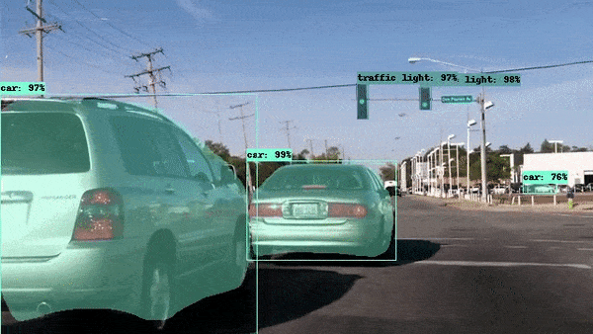
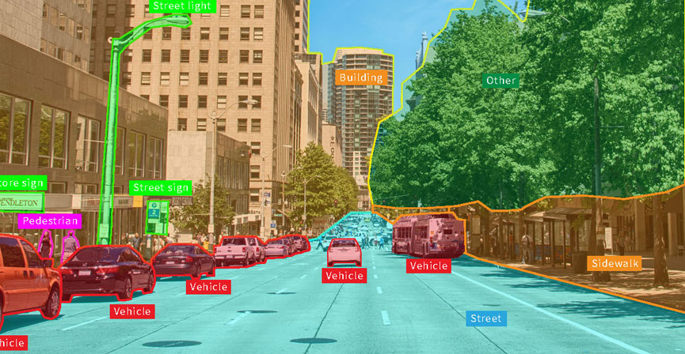
Computer Vision
Allows computers to see, observe, and understand.

Slide 5
The Code
https://bit.ly/3PoRoU5

Slide 6
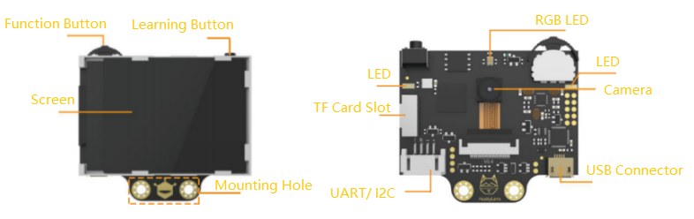
Huskylens

Slide 7
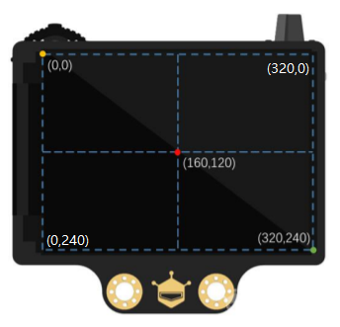
Huskylens Coordinates

Slide 8
Thank You!
josh@thedaringwolf.com

